Slide 1
Genetic Algorithms
Owais A. Hussain

Slide 2
Outlines
Shakespeare and monkey with a keyboard
Socrates or Jean-Paul Satre?
The cost of Brute force and the age of Universe
Series guessing riddle
Mona Lisa
Darwinian natural selection
Genetic algorithms
In action

Slide 3
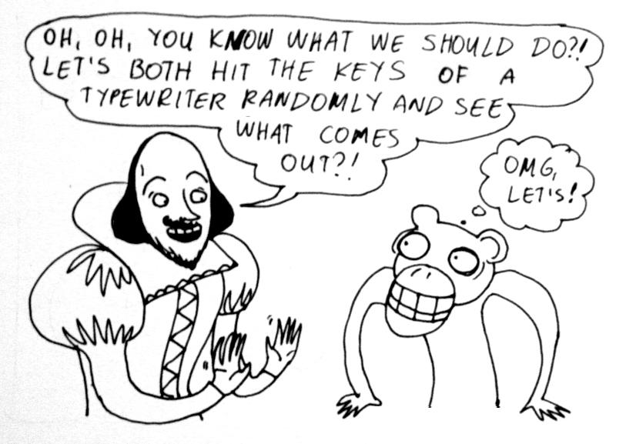
Shakespeare and monkey with a keyboard

Slide 4
Socrates or Jean-Paul Satre?
To be is to do – Socrates
To do is to be – Jean-Paul Satre
Let’s target: “To be is to do or to do is to be”
The monkey starts typing… when will he have typed the above phrase?

Slide 5
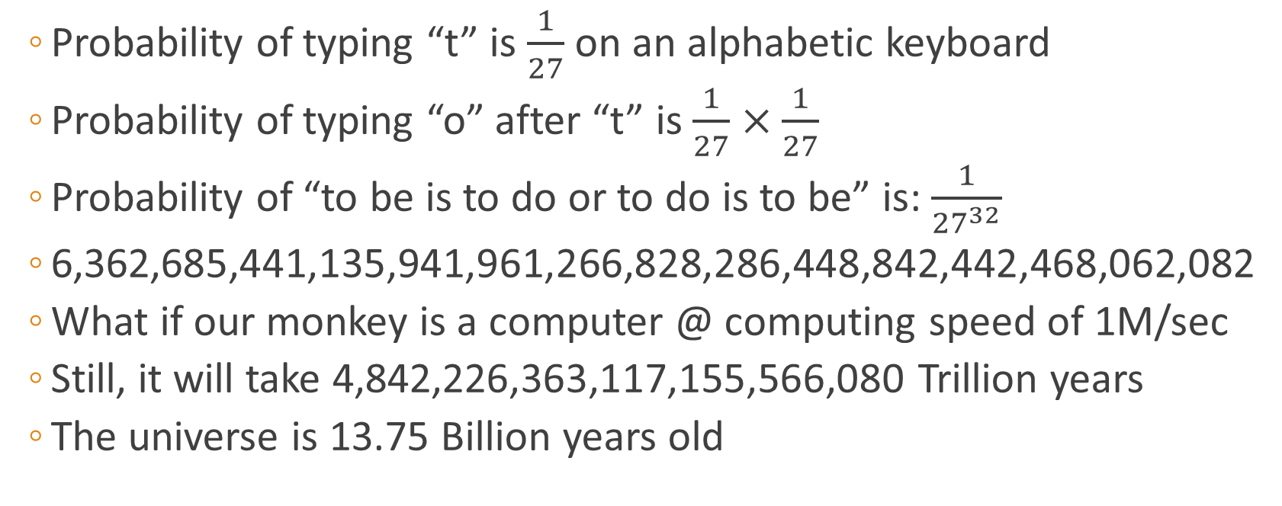
The cost of Brute force and the age of Universe
Probability of typing “t” is $\frac{1}{27}$ on an alphabetic keyboard
Probability of typing “o” after “t” is $\frac{1}{27}×\frac{1}{27}$
Probability of “to be is to do or to do is to be” is: $\frac{1}{{27}^{32}}$
6,362,685,441,135,941,961,266,828,286,448,842,442,468,062,082
What if our monkey is a computer @ computing speed of 1M/sec
Still, it will take 4,842,226,363,117,155,566,080 Trillion years
The universe is 13.75 Billion years old

Slide 6
Series guessing riddle
I have a numerical series in mind
0 lies in this series
1 lies in this series
3 does not lie in this series
Negative numbers do not lie in this series
You can ask if a certain number falls in my series
I will only answer in Yes/No
Let’s play…
Notes:
All positive integers not divisible by 3

Slide 7
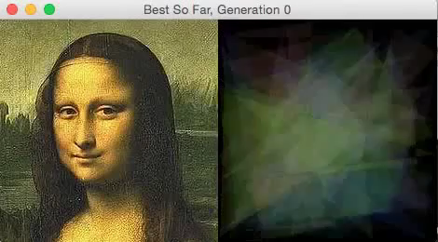

Slide 8
Darwinian Natural Selection
Heredity: children receive genetic properties of their parents.
Selection: some (but not all) parents may transfer their genetic information to their children.
Variation: population has the ability to make variation to the genetic properties transferred by their parents.

Slide 9
Genetic Algorithms
Setup: create a random population
Generation:
Evaluation: calculate fitness of population by defining a fitness formula
Selection: pick two or more (but not too many) most fitting elements
Regeneration:
Crossover: combine parts from selection by crossover to generate new candidates
Mutation: the variation we make to the selection when crossing over
Add the new element to a new population set
Replace: old population is overridden with the new population
Notes:
An example of fitness formula is the number of characters in random population which match the target phrase.
Most fitting elements in selection are the ones closest to the target phrase
Mutation ensures that there’s enough variable between the population to proceed. We can keep mutation rate to be 0 if the population for selection is high

Slide 10
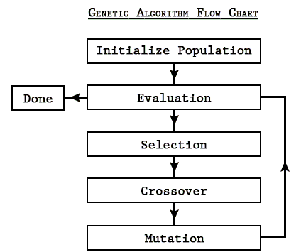
Genetic Algorithms
Notes:
A.k.a. Randomized search algorithms

Slide 11
In action
Assume our goal is to guess the word SAMSUNG
We can pick all 7-letter words from English dictionary and call it population. Our collection will be like: SAMURAI, PUZZLED, FEEDING, PURSUIT, BILLION, …
Evaluation: compute goodness of fit of each word:
SAMURAI = 4/7; PUZZLED = 1/7; FEEDING = 2/7; PURSUIT = 2/7; BILLION = 1/7
Selection: SAMURAI, FEEDING, PURSUIT
Crossover: SAMFEET, SAMDINT, …, SAMINGU, FEESAMU, SUSAMDI, NGSAMUS, …
Mutation: SAMREET, SAFDINT, …, SUMINGU, PEESAMU, SUSAMDN, NGSAMUF
Repeat…

Slide 12
Code
Write a program which uses genetic algorithm to guess the word: ABRACADABRA
Use only CAPITAL letters.
Random population size should be 25 or less.
Select no more than 5 best candidates for regeneration.
No need to reinvent the wheel, to find out goodness of fit, calculate Levenshtein Distance between guess and candidates.
Stop when exact match is found and return the number of generations it took to guess the word.

Slide 13
?

Slide 14
Thank you…

